Slide 1
Avoiding Fair Market Value Pitfalls
Robert A. Wade, Esq.
Partner
Baker & Daniels LLP
202 South Michigan Street
Suite 1400
South Bend, Indiana 46601
(574) 239-1906 – Direct Dial
(574) 472-4576 - Facsimile
bob.wade@bakerd.com
Timothy Smith, CPA/ABV
Manager
HealthCare Appraisers, Inc.
Dallas Office
1333 W. McDermott Drive
Suite 200
(469) 519-1201 – Phone
(469) 519-1202 – Facsimile
djohnson@hcfmv.com

Slide 2
“What do you mean by FMV?”
In the healthcare context, there are
essentially 3 basic views on the meaning
of FMV:
  “Person on the street” perspective
  Professional appraisal perspective
  Legal/regulatory perspective
Unfortunately, these 3 basic views frequently conflict.
Parties can get “dazed and confused” when these 3 competing views meet to complete a transaction.

Slide 3

“The Street” View of FMV
“What everyone is getting paid in the
market”
“What the hospital down the street is
paying”
“Incremental cost plus a profit margin”
“What’s in a survey book”
“What it’s worth to one party to the transaction”

Slide 4

Professional Appraisal View of FMV
“The price, expressed in terms of cash equivalents, at which property would change hands between a hypothetical willing and able buyer and a hypothetical willing and able seller, acting at arm’s length in an open and unrestricted market, when neither is under a compulsion to buy or sell and when both have reasonable knowledge of the relevant facts.”
(International Glossary of Business Valuation Terms)

Slide 5
Professional Appraisal View of FMV
Based on the “hypothetical-typical” buyer concept
FMV contrasts with investment value or strategic value
Determination of FMV is based on 3 approaches to value:
  Cost
  Income
  Market
Formal body of knowledge and professional standards governing the appraisal practice for real estate and business valuation (“BV”)
No current body of knowledge or standards for compensation valuation (“CV”)

Slide 6

Legal/Regulatory View of FMV
Stark Definition:
FMV is defined as the value in
arm’s-length
transactions, consistent with the
general market value. General
market value means the compensation that would be included in a service agreement as the result of bona fide bargaining between well informed parties to the agreement who are not otherwise in a position to generate business for the other party.

Slide 7
Legal/Regulatory View of FMV
Stark regulations state that the definition of FMV “is qualified in ways that do not necessarily comport with the usage of the term in standard valuation techniques and methodologies.”
Stark example:
Exclusion of market comparables between parties in position to refer
Stark example:
FMV can be established by “any method that is commercially reasonable.”
OIG Anti-kickback statute example:
Footnote 5 to Advisory Opinion 09-09 cautioning the use of the DCF method for an ASC valuation

Slide 8

Avoid the FMV Definition
Pitfall
The “Street” perspective of FMV is
generally not reliable for healthcare
regulatory purposes but may provide
useful information.
Regulatory definition of FMV may limit or qualify FMV methods used in professional appraisal practice.
FMV as determined under professional appraisal standards may be more rigorous than
the regulatory requirements.

Slide 9
Avoid the FMV Definition Pitfall
Learn to identify and navigate through the different views of FMV as they arise in negotiating transactions and compliance reviews.
Recognize that appraisal professionals do not give regulatory advice, but only their opinion as to the determination of FMV, which may or may not take into account regulatory considerations.
Strive for an efficient relationship between the parties who determine FMV.

Slide 10
Loss of Control
Of Payment Allocation
Memorial Health University Medical Center Settlement. Government alleged that Memorial paid above market for administrative services and compensation was pooled permitting top referral source to obtain disproportionate share of compensation. Memorial Health paid $5,080,000 to settle the case.
Notes:
10

Slide 11

Compensation Stacking
Provider entering into multiple compensation arrangements that would be:
i) above a full-time equivalent (1.0 FTE); and
ii) highly unlikely that a physician could perform all duties either because of the number of hours required or for quality reasons.
Notes:
11

Slide 12

On-Call Compensation “Stacking” with Employed Physicians
Case Study: Neurosurgeon in private
practice seeks employment based on a
wRVU model.
  Physician currently receives $2,000
  per shift for on-call pay.
  Should the physician continue to
  receive the full $2,000 per shift in
  addition to his compensation per
  wRVU model?

Slide 13
The “No Risk” Risk Premium
FMV should not be influenced by the inclusion of gratuitous contract provisions that add “false” risk.
Examples –
  Early termination provisions that are not likely to be exercised
  The perpetual renewal of a one-year lease
  Leaseback arrangements for space or personnel
Notes:
13

Slide 14
Independent Contractors/Medical Directorships
Use of clinical v. administrative benchmarks.
Role or number of hours are not reasonably needed or required (i.e., developing arrangement only to “retain” physician in service area).
Hours worked not documented.
See Exhibit A (Time Card) and
Exhibit B (Monthly Tracking Tool).
Notes:
14

Slide 15
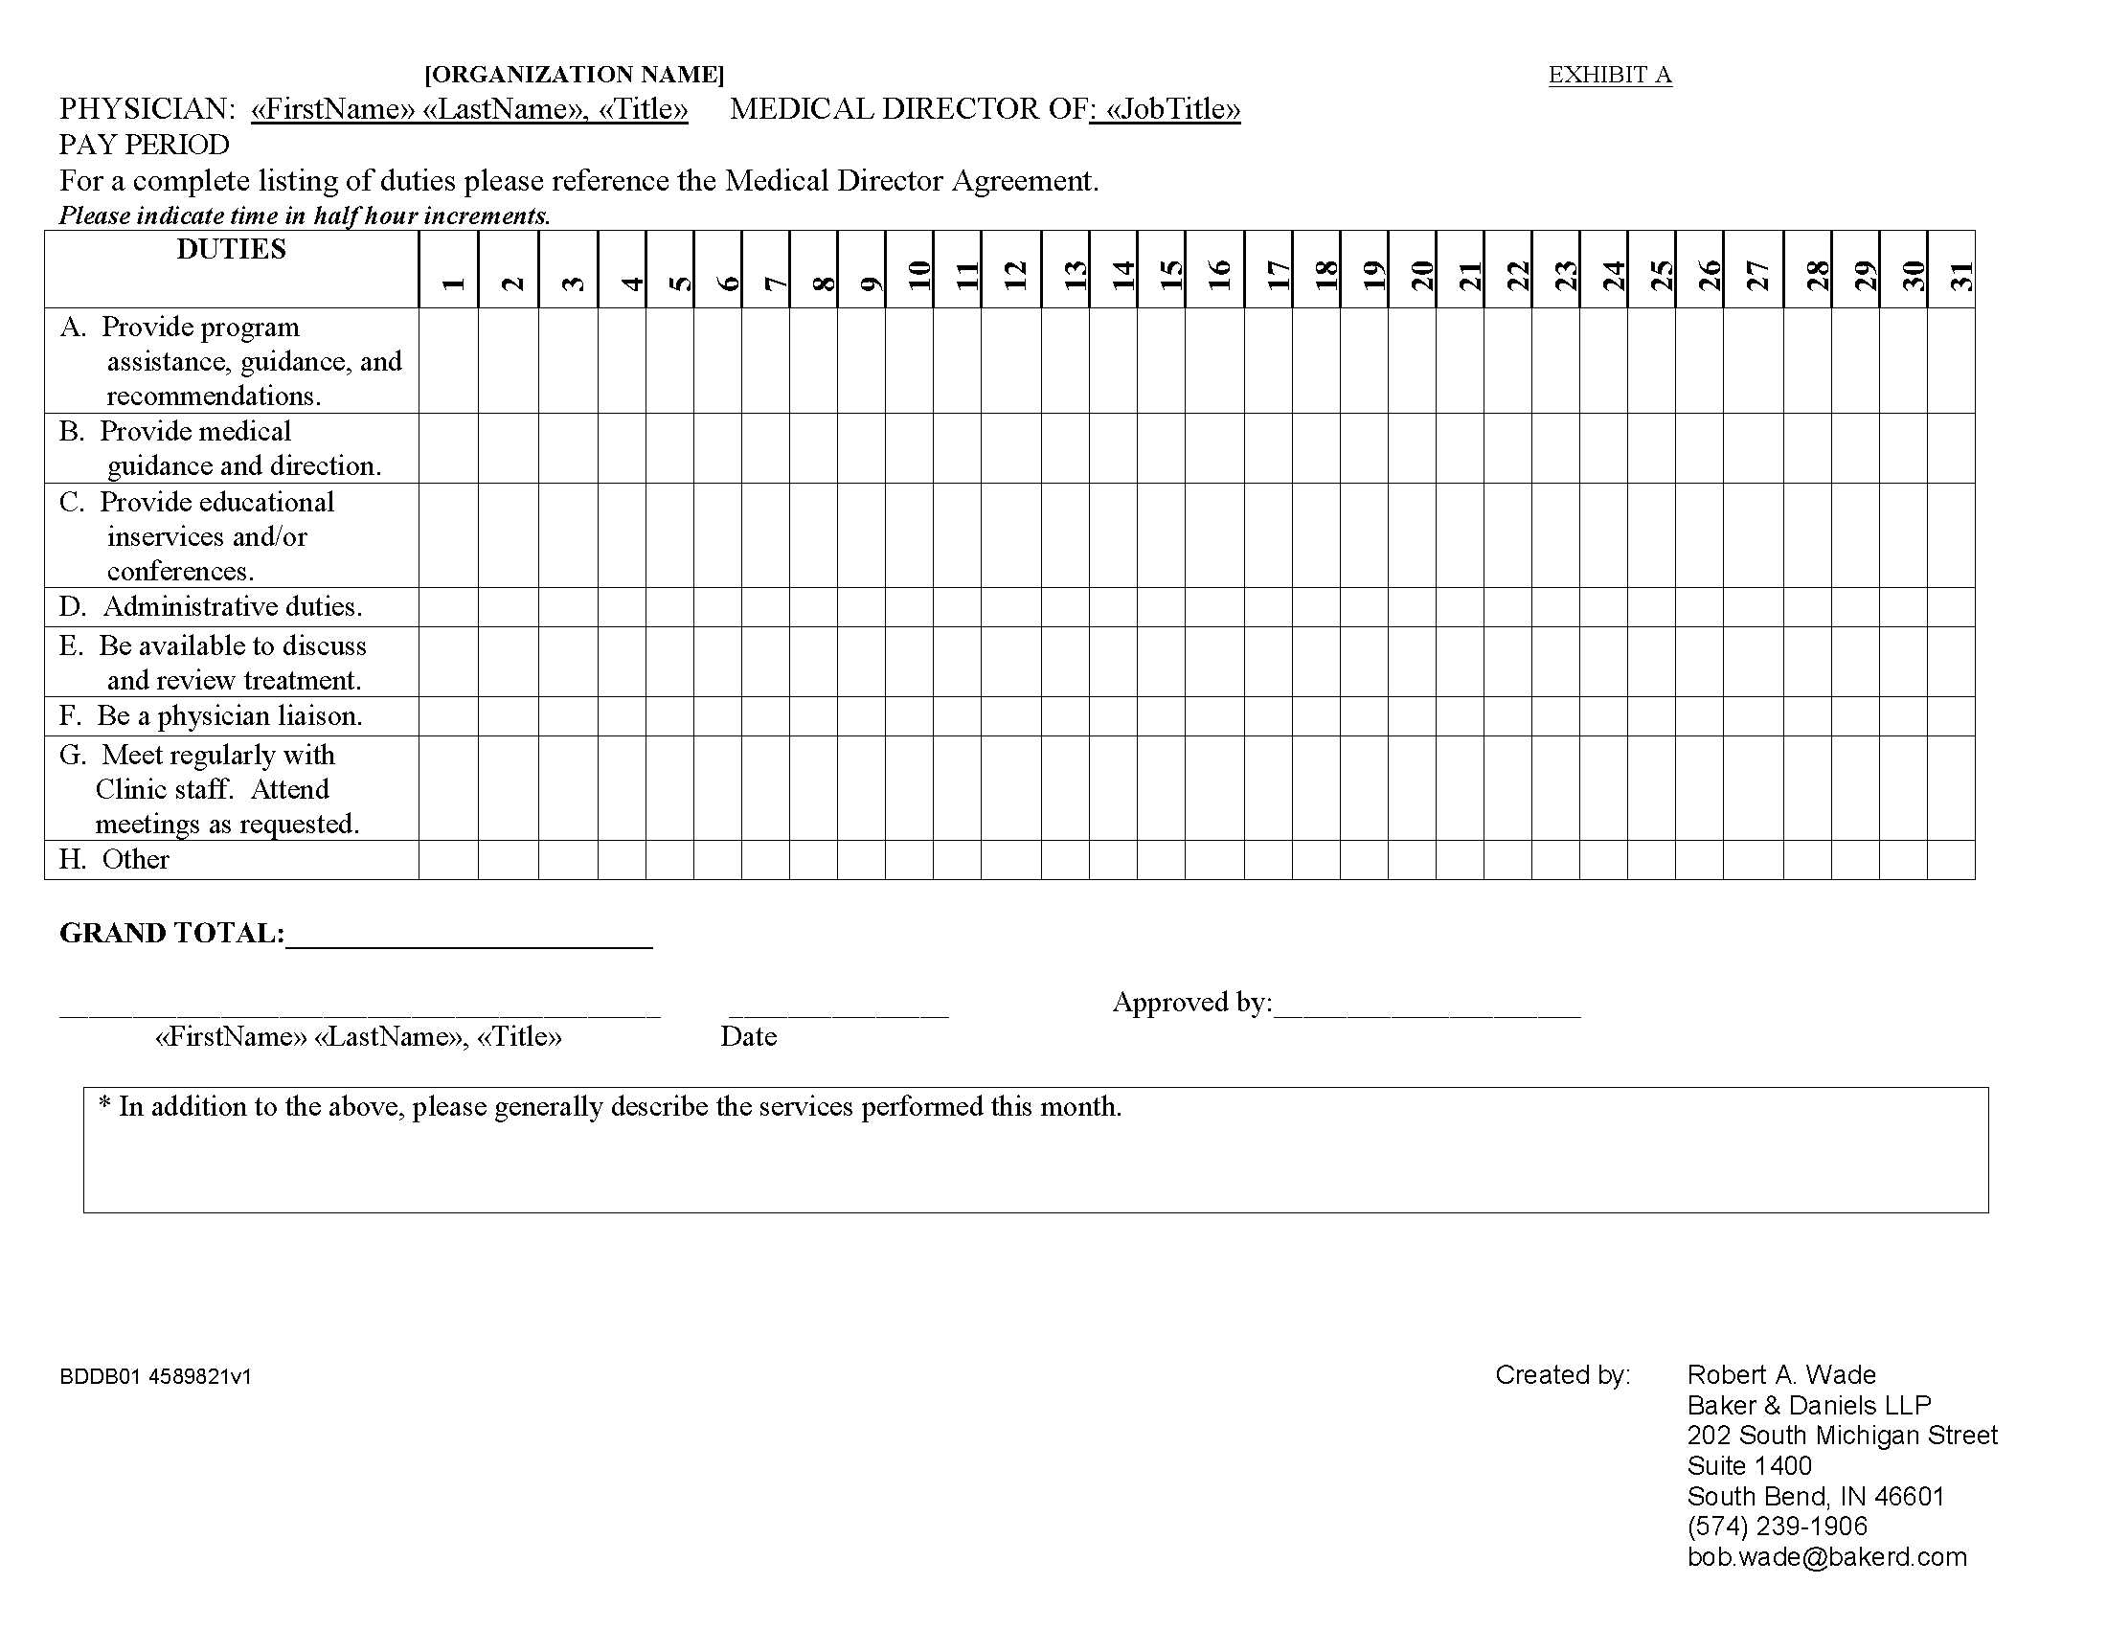

Slide 16
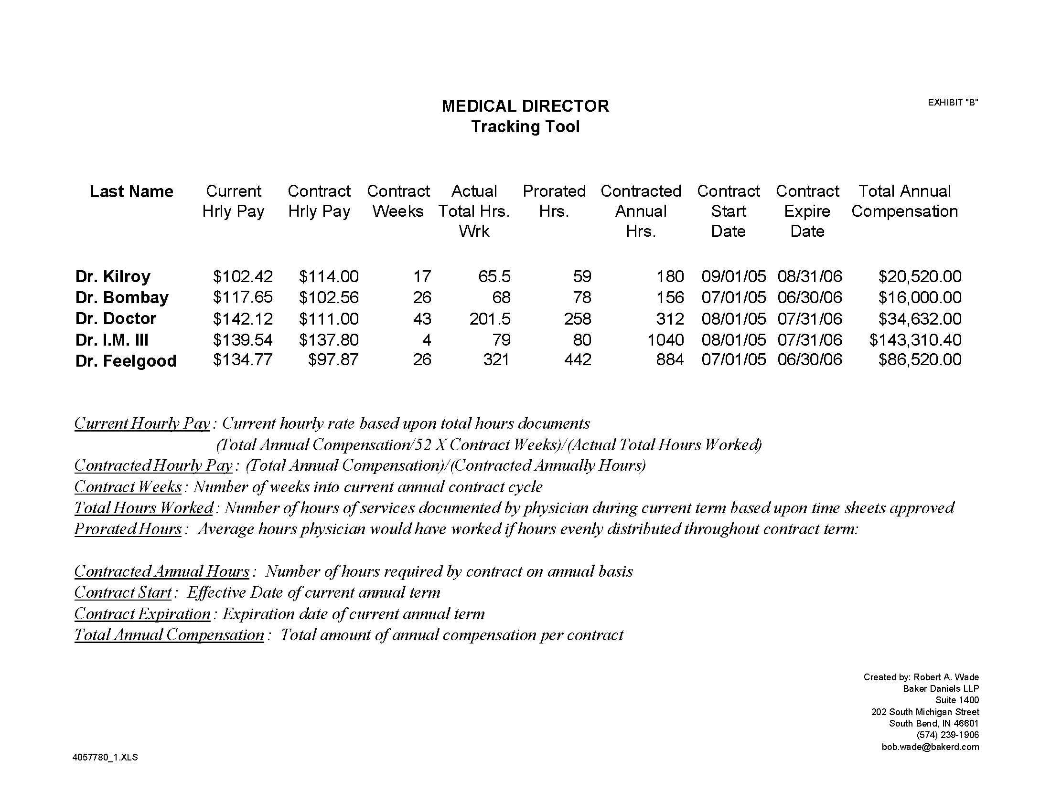

Slide 17
Commercial Unreasonableness
While most conceivable compensation arrangements can be valued, when does an arrangement lack commercial reasonableness?
  Advertising on physician practice websites by recipients of referrals (e.g., pathology labs)
  Payment to physicians to coordinate their own on-call schedules
  Lease arrangements for equipment that should be purchased
  Hospital transaction costs that exceed the value of the underlying transaction
Notes:
17

Slide 18
Real Estate: High Risk
Gross v. triple net lease documentation to support lease amount
Incorrect square footage for leased space
Hospital/lessor losing money on real estate holdings when most real estate leasing companies in market are generating profit/margin
Not charging for increases in maintenance or annual increases when lease contemplated such increases
Enhanced tenant improvements not factored into lease rate
Notes:
18

Slide 19
Real Estate: High Risk
Time share arrangements
  Not accounting for “vacancy” in time share arrangements
  Time share “creep” (i.e., using staff, supplies, or specialized equipment not factored into time share compensation arrangement)
Notes:
19

Slide 20
Tenant Improvements Allocations
$45
$40
$35
$20
$22
$24
Per square foot lease rate
Notes:
20

Slide 21

Real Estate - Shared Space
Must allocate all costs
Rental of space (Half or
Full Day Slots)
Vacancy Rate (Project
20% vacancy?)
Supplies
Utilities
Staff (Registration, Nursing, etc.)
Equipment
Notes:
21

Slide 22
Real Estate
Shared Space - Example
Assume the following:
$18 gross per square foot rental (exclusive use)
30% projected vacancy
1,000 square feet in suite
Building has 6,000 square feet, with 1,000 square feet for common area (5,000 square feet usable space)
Suite capable of being leased in half day increments (8:00 A.M. – Noon; 1:00 P.M. – 5:00 P.M.)
Notes:
22

Slide 23

Real Estate
Shared Space - Example
Furniture and equipment in suite determined to be leaseable at $2,000 per year using independent third party leasing company.
Miscellaneous medical/office supplies projected to be used in suite is approximately $5,000 annually if suite leased 70% of the time
Notes:
23

Slide 24

Real Estate
Shared Space - Example
  What is the fair market value/commercially reasonable rate for one half day?
Notes:
24

Slide 25

Real Estate
Shared Space - Example
$18 (exclusive use rate) + 30% (vacancy) = $25.71 per square foot ($18 ÷ .7 = $25.71)
1,000 square feet (suite) ÷ 5,000 square feet (building not including common area) = 20% (percentage of suite’s usable space in building’s usable space)
1,000 square feet (common area) x 20% (suite to building)
= 200 square feet (common area allocated to suite)
Notes:
25

Slide 26
Real Estate
Shared Space - Example
1,200 square feet (suite plus allocated common area) x $25.71 = $30,852
$30,852 + $2,000 (furniture and equipment) + $5,000 (medical/office supplies) = $37,852
$37,852 ÷ 52 (weeks) = $728 (weekly rate)
$728 ÷ 5 (business days in week) = $146
(daily rate)
$146 ÷ 2 = $73 (half day rate)
Notes:
26

Slide 27

Real Estate
Shared Space - Example
What is $73 Alex?
Notes:
27

Slide 28

Real Estate
Shared Space - Example
Example becomes more complicated if:
Part of suite is leased (as opposed to full suite)
Staff is provided by landlord/hospital
Specialized equipment is
used
Non-standardized supplies
are used by a tenant
Notes:
28

Slide 29
Ancillary Revenue
Compensation in an employment arrangement is based, in part, on ancillary revenue generated by the employed physician’s referrals to employer/hospital.
Example: The specialty of oncology generates substantial revenue from ancillary services.
Notes:
29

Slide 30
Misuse of RVUs
Overview of relative value units (or RVUs)
Key difference between total RVUs and work RVUs
  Total RVUs include work, practice expense and malpractice.
Possible over-counting due to:
  Assistant at surgery
  Multiple procedures
  Midlevel providers
  Site of service differences
Notes:
30

Slide 31
National Benchmark Data Mistakes
Poor alignment of compensation v. productivity
Use of worked RVUs v. total RVUs
Employment v. shareholder data – most benchmarks combine, but some benchmark sources separate the data. This is most notable in specialties that generate substantial income from ancillary services. For the specialty of oncology, as reported in the 2008 MGMA Report, the 90th percentile for shareholders is $966,135 and for employees is $515,705.
Notes:
31

Slide 32
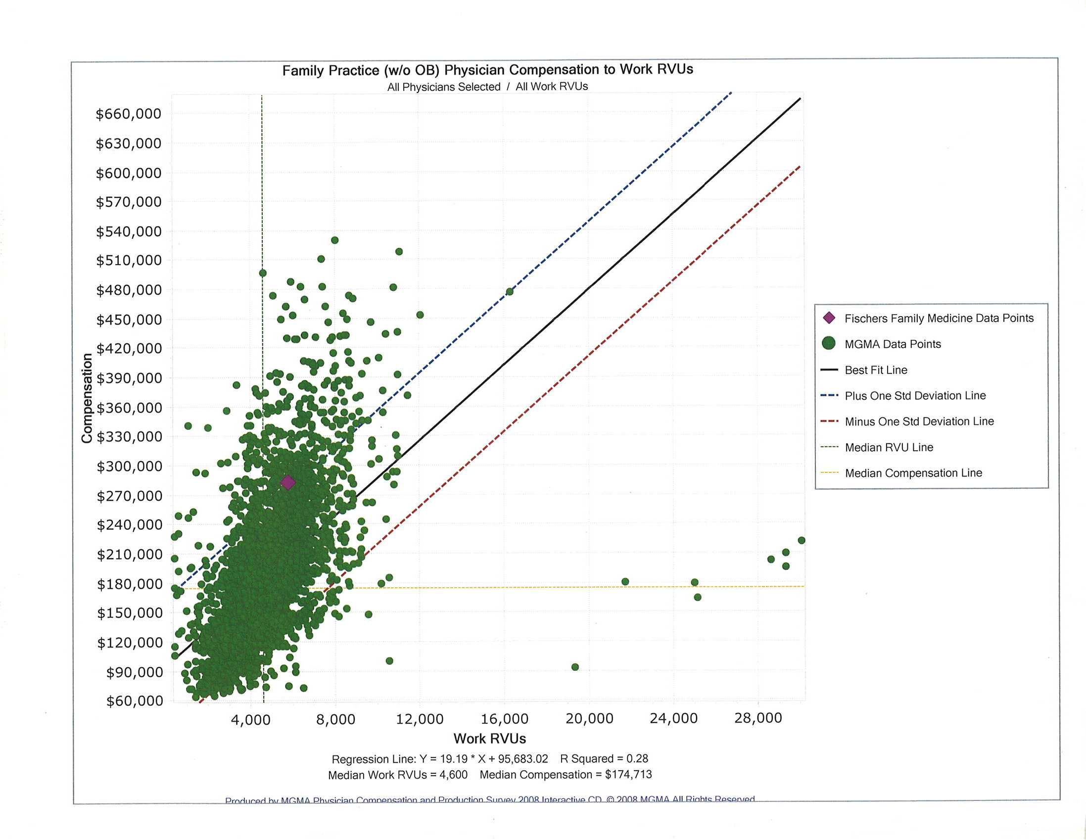

Slide 33

Matching Compensation to Services Provided
Case Study: Internist in private practice
seeks employment under a base salary
and incentive bonus model commensurate
with her current level of compensation.
  She currently makes $400,000 per year from her practice that includes several MLPs who generate twice their salary and benefit cost in collections.
  What should her compensation level
  be under employment?

Slide 34
Misconceptions of the Survey Data
#1 – The surveys are the definitive snapshot of physician compensation in the marketplace.
Participants are not selected using statistical sampling methods.
Each survey tends to represent a different segment of the marketplace.
  MGMA and AMGA: Larger multispecialty groups
  SCA: Health system-affiliated physicians

Slide 35
Misconceptions of the Survey Data
#2 – The surveys present compensation for clinical physician services.
Most surveys report compensation from all sources, including:
  Compensation for clinical services
  Owner compensation
  Ancillary compensation
  Medical directorships and call coverage

Slide 36
Misconceptions of the Survey Data
#3 – Regional or state data better reflect my local marketplace.
Regional data may be concentrated from respondents in a small number of states or even a single state.
State data may reflect participants in a few locales with varying market dynamics.
State data often has a limited number of respondents.

Slide 37
Misconceptions of the Survey Data
#4 – Compensation and productivity always correlate in the survey data.
Regression line analysis on the MGMA data indicates the correlation between compensation and wRVUs or pro collections may be limited in various specialties.
Correlation between pro collections and comp tends to be higher than wRVU correlation.
Correlation can vary significantly from year to year.

Slide 38
Misconceptions of the Survey Data
#5 – Compensation per wRVU rate should correlate with a physician’s wRVU productivity level.
According to MGMA, there is an inverse relationship in its survey data between productivity and the comp/wRVU rate.
  Highest wRVU producers have the lowest comp/wRVU rate.
  Lowest wRVUs producers have the highest comp/wRVU rate.

Slide 39
Proper Use of the Survey Data
Avoid uncritical use of the surveys, i.e. simply “pulling numbers out of a book”
  Compare subject physicians to survey respondent profiles and to multiple productivity measures
Avoid assumptions about the data
Use multiple surveys and measures
Read the survey introduction, definitions, and questionnaire!
Use sensitivity testing on compensation models
Prepare a solid and thorough pro forma

Slide 40

Multiple On-Call Payments
Physicians can be on call at multiple hospitals. However, if the same physician is being paid by multiple hospitals, physician must have dedicated backup for multiple on-call payments to be defensible.
Notes:
40

Slide 41
Misapplication of a FMV Opinion
Examples –
  Opinion was valid only over a range of outcomes
  Misapplied “units” (e.g., surgical cases vs. procedures; unrestricted vs. restricted call; 24-hour on-call rate applied to a 14-hour call period)
  FMV opinion is ambiguous or conditional
  FMV opinion included critical governing assumptions that were not considered in its application
Notes:
41

Slide 42
Reimbursement of Clinical Expenses for Administrative Role
If a hospital has an administrative compensation arrangement with a physician (i.e., medical directorship), hospital should only reimburse expenses that are directly related to the administrative role.
Bad Examples: Clinically-oriented CME, compensation for administrative role when billing for clinical services.
Notes:
42

Slide 43
Use of Tainted Market Data
On-Call compensation - SullivanCotter indicates that only 9% of hospitals establish on-call payment rates through FMV analysis.
  57% use a consensus process involving management and physician leadership
  41% negotiate individually with each physician/practice
Virtually all compensated on-call arrangements exist between physicians and hospitals to which they refer
  Source: 2008 Physician On-Call Pay Survey Report, SullivanCotter and Associates, Inc.
Notes:
43

Slide 44
Use of Tainted Market Data
The all time favorite…lithotripsy.
Virtually no “untainted” market values exist.
Even once “independent” litho providers found they needed to JV with physicians to survive.
A Cost Approach can demonstrate if lithotripsy margins are inordinately high.
Consequences to a hospital include loss of lithotripsy procedures…and loss of all other procedures performed by urologists.
Notes:
44

Slide 45
The “Behind the Scenes” Management Company
A physician practice (the “Manager”) that engages a third party management company to fulfill the Manager’s obligations to a hospital may undermine the arrangement.
  Both the Manager and the third party management company may seek a “full profit” for their efforts.
  The Manager may appear to be profiting from arbitrage, or the overall arrangement may appear to be a sham.
Notes:
45

Slide 46
Memorial Health University Center
In 2008, Memorial Health negotiated new contracts with Provident Eye Physicians, its affiliate that provides ophthalmologic services to its patients
The 2003 contracts did not account for the physicians’ teaching and indigent care services
To correct error, Memorial Health paid Provident Eye Physicians $500,000 per year between 2008 and 2005, and $600,000 per year for 2006

Slide 47
Memorial Health University Center
The annual payments were not distributed to the physicians performing the teaching and indigent care services
Instead, the payments were channeled to a small number of high referring physicians that Memorial wanted to keep content
As a result, the payments constituted an indirect compensation arrangement between the physicians and Medical Center

Slide 48
Memorial Health University Center
No applicable Stark exception was met. The payments to Provident “varied with the volume or value of referrals or other business generated by the referring Provident physicians” and Memorial acted in reckless disregard of the arrangement
Memorial settled with the OIG for $5.08 million

Slide 49
Covenant Medical Center
Covenant Medical Center paid five employed physicians amounts that the government alleged were above fair market value and commercially unreasonable.
Compensation formulas were based on personally performed services and, according to the defendant, consistent with fair market value.
Salaries were among the highest in the nation, according to DOJ.
Covenant settled the FCA allegations, based on the underlying Stark violations, for $4.5 million.

Slide 50
Medtronic Whistleblower Lawsuit
Targeted physicians for improper consulting and royalty agreements in violation of the Anti-Kickback Statute
  Targeted over 100 orthopedic spine surgeons, neurosurgeons, medical practices and distributors of taking kickbacks from Medtronic for using their products, promoting off-label use of FDA-approved devices, and filing Medicare claims in violation of the False Claims Act

Slide 51
Medtronic Whistleblower Lawsuit
Allegations that physicians accepted:
  Consulting fees when no services were performed
  Consulting fees for more than fair market value of their services
  Royalties for patents on which they were not true inventor
  Improper gifts given, including textbooks
  Excessive travel
  Consulting compensation based on amount of business they created

Slide 52
Medtronic Whistleblower Lawsuit
Lawsuit dismissed in March of 2009. Judge stated that the plaintiffs were barred from going forward because plaintiffs in other lawsuits and the news media had aired the lawsuit’s allegations previously.
Nevertheless, the lawsuit forced all parties, including individual physicians, to spend countless dollars on legal fees.

Slide 53
United States v. Rogan
7th Circuit upheld $64 million fine against Peter Rogan, manager and financial beneficiary of Edgewater Medical Center for False Claims Act Violation
  Anti-Kickback Statute and Stark Act violated through improper payments to physicians
    Medical director agreements, physician recruiting contracts, teaching contracts, EKG-reading contracts, and physician loan agreements, which provided doctors with compensation that court found was “grossly” above fair market value for services never substantially performed

Slide 54
Christ Hospital (Cincinnati)
Qui tam lawsuit, filed by cardiologist Dr. Harry Fry, settled with government on February 2, 2010
Agreement must be finalized by March 30, 2010
$424 Million aggregate exposure from Heart Alliance, $123 Million for Christ Hospital
Cardiologists allocated time at Heart Station to perform electrocardiograms, echocardiograms and stress tests based upon revenue generated for Christ Hospital the previous year

